Slide 1

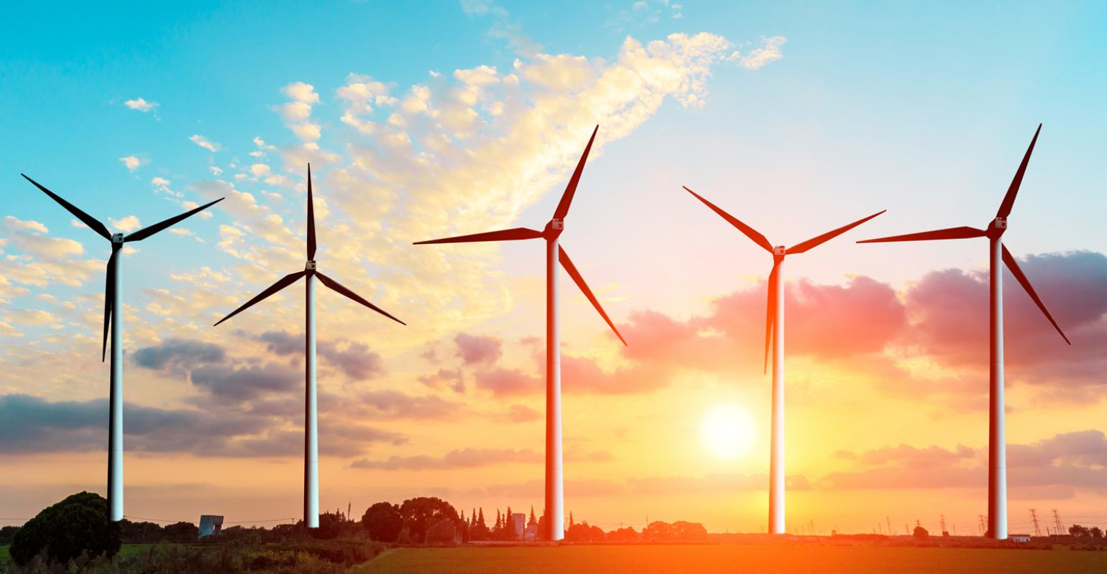
Utilizing unused renewable energy

Slide 2
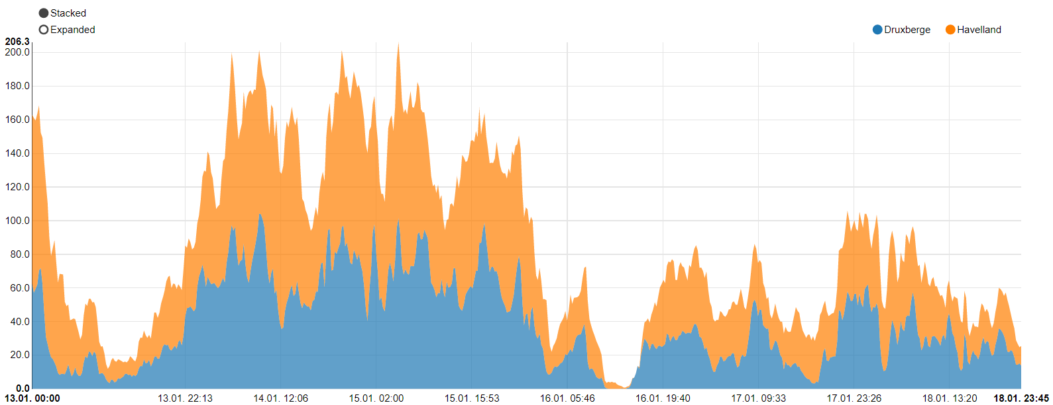

Problem
Power production is inconsistent
Excess energy is generated
Power (MWh)
Figure 1: Peaks and lows of onshore wind power plants in Germany
Source: https://www.energy-charts.de/power.htm?source=wind-onshore&year=2020&week=3

Slide 3
Energy storage systems
Possible solution?
Which system fits best?
Vehicle to grid
Power-to-Gas
Hydrogen
Excess energy
Battery storage
Pumped hydro storage

Slide 4
Introduction
1. Vehicle to grid
2. Hydrogen as an energy storage system
3. Pumped storage hydropower
4. Power-to-Gas
5. Batteries

Slide 5
Vehicle to grid

Slide 6
Hydrogen as an energy storage system

Slide 7
Pumped storage hydropower

Slide 8
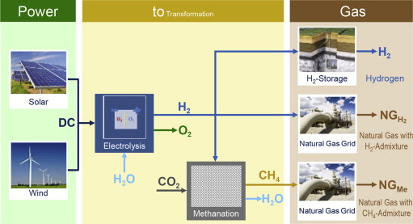
Power-to-Gas
Figure X: Power-to-Gas concepts

Slide 9
Batteries

Slide 10
Comparison
Criteria
 | Cost | Efficiency | Safety | Scalability | Technical feasibility
Vehicle to grid | - - - | + | + + + | - - | - - -
Pumped storage hydropower | + | + + + | + + | + + | - -
Hydrogen | - - | - - - | + + | + + + | + + +
Power-to-Gas | - - | + | + + | + + + | + + +
Batteries | + + + | + + | + + | + + + | + +
Systems
Table 1: Comparison between energy storage systems

Slide 11

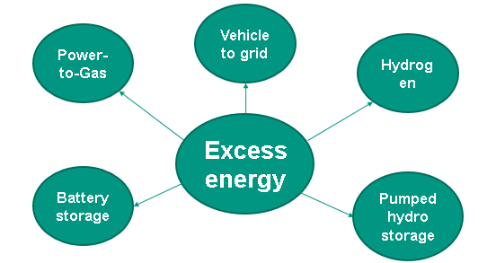
Conclusion
Various technologies technically feasible and scalable
Overall best solution → Battery storage

Slide 12
Recommendations
Construction of Battery Storage Facilities as soon as possible
Best current solution
Rapid developments into Hydrogen could substitute Batteries in the future

